Slide 1
Use of Digital Technology to calculate water footprints for different daily use items
CSE7101- Capstone Project
Review-5
Batch Number: IST_27
Under the Supervision of,
Mr.Saptarsi Sanyal
Assistant Professor
School of Computer Science and Engineering
Presidency University
Roll Number | Student Name
2O221IST0017 | Bolla Sagarika
20221IST0002 | Gandavaram Sravanthi
20221IST0003 | Bathina Mounika
Name of the Program: IST
Name of the HoD: Dr. Pallavi R
Name of the Program Project Coordinator: Ms.Benitha Christinal J
Name of the School Project Coordinators: Dr. Sampath A K , Dr. Geetha A

Slide 2
CONTENT
Abstract
Literature Survey
Objectives
Existing Methods and Drawbacks
Proposed Method & Feasibility Study
Architecture Diagram
Modules
Result
Conclusion
Timeline (Gantt Chart)
References

Slide 3
Problem Statement
Organization: Aiming to create impactful digital solutions that contribute to sustainable
development goals, specifically addressing global water conservation issues.
Category : Software + Hardware (IoT Project)
Problem Description: Water scarcity is becoming a major global concern due to population
growth, industrialization, and unsustainable consumption patterns. Many individuals remain
unaware of the amount of water required to produce the items they use daily—such as food,
clothing, electronics, and household products. Traditional methods of estimating water
footprints are often manual, complex, and lack real-time data, making them inaccessible for the
general public and small organizations. This gap in awareness and lack of user-friendly tools
prevents people from making informed, water-conscious choices. Therefore, there is a need for
a digital, automated, and accurate system that can calculate, analyze, and present the water
footprint of different daily use items in a simple and interactive manner.

Slide 4
Abstract
Water is one of the most critical resources for human survival and sustainable development. However, rapid urbanization, population growth, and consumption patterns have placed enormous pressure on freshwater availability. Understanding and monitoring the water footprint of daily use items—such as food, clothing, and household products—has become essential for promoting responsible usage. This project explores the use of digital technologies to calculate and analyze water footprints in real time. By integrating IoT sensors, data analytics, and visualization dashboards, the system enables accurate tracking of water consumption linked to different products and activities. The methodology adopts the V-Model framework to ensure structured development, from requirement analysis to testing and evaluation. Simulation results demonstrate that digital tools can improve awareness of water usage and achieve accuracy levels exceeding 95% in water footprint estimation. The project not only highlights the role of technology in advancing sustainable practices but also aligns with global goals such as SDG 6 (Clean Water and Sanitation) and SDG 12 (Responsible Consumption and Production). Ultimately, the system provides individuals and communities with actionable insights, encouraging informed decisions and contributing to long-term water conservation.

Slide 5
Literature Survey
Author / Year | Focus of Study | Digital Technology Used | Key Findings | Relevance to Water Footprint Calculation
A. Y. Hoekstra et al.[1] | Water Footprint Manual: State of the Art 2011 | Development of standardized framework for water footprint assessment | Introduced blue, green, and grey water footprint calculation methods | Lacks digital/automated tools for real-time footprint measurement
J. Allan et al.[2] | Virtual Water: Tackling the Threat to Our Planet’s Most Precious Resource | Conceptual study on virtual water flows | Highlighted importance of virtual water in global trade | Does not provide computational/technology-based tracking systems
M. M. Mekonnen et al.[3] | Water footprint of crops and crop products | Quantitative analysis using global datasets | Calculated green, blue, and grey footprints for many crops | No integration with IoT, apps, or real-time monitoring
Zhang et al.[4] | IoT-based water monitoring system for smart cities | IoT sensors, cloud monitoring | Real-time tracking of water usage in cities | Focused on municipal monitoring, not personalized water footprint

Slide 6
Literature Review
Author / Year | Focus of Study | Digital Technology Used | Key Findings | Relevance to Water Footprint Calculation
R. Smith, et al.[5] | Digital tools for sustainability education | Review of digital learning platforms | Digital tools improved awareness and behavior | No specific tools for water footprint education
P. Jones et al.[6] | Software architecture for environmental footprint calculation | Software design models for environmental analysis | Proposed architecture for footprint computation systems | Proposed architecture for footprints
T. Nguyen et al.[7] | Mobile app for water conservation awareness | Android-based educational app | Improved user awareness and reduced water usage | App did not include footprint calculation or sensor data
K. Patel et al.[8] | IoT + database integration for environmental monitoring | IoT sensors + cloud databases | Enabled large-scale data collection and analysis | Not specific to water footprint; lacks calculation models

Slide 7
OBJECTIVES:
To develop a digital system that calculates the water footprint of various daily use items using standardized scientific methods (blue, green, and grey water footprints).
To integrate digital technologies such as mobile applications, IoT sensors, or web-based dashboards for automated data collection, processing, and real-time analysis.
To create a user-friendly interface that allows individuals to easily view, compare, and understand the water footprint values of commonly used products.
To promote awareness about hidden water consumption by providing visual insights and data-driven reports on water usage patterns.
To support sustainable decision-making by offering recommendations to reduce personal or household water footprints.
To contribute to environmental sustainability goals, particularly SDG 6 (Clean Water and Sanitation) and SDG 12 (Responsible Consumption and Production).
To ensure system accuracy and reliability through validation using standard water footprint calculation models and available databases.

Slide 8
Existing Methods and Drawbacks
Existing Methods 1. Manual Calculation Using Water Footprint Assessment Framework Researchers and organizations use the Water Footprint Network (WFN) methodology to manually calculate blue, green, and grey water footprints.
2. Spreadsheet-Based Calculators Simple Excel-based or Google Sheet–based calculators are used by students, researchers, and small institutions.
3. Online Web Calculators (General Water Usage Tools) Some websites allow users to estimate domestic water use.
Typically calculate only direct water usage, not the water footprint of products.
4. Research Papers and Static Databases Databases list water footprint values for food items, clothing, and industrial products. These are static and cannot adapt to real-time changes or specific user scenarios.

Slide 9
Existing Methods and Drawbacks
Drawbacks of Existing Methods 1. Lack of Real-Time Data Most existing tools use static information or outdated datasets. Cannot reflect real-time consumption or changes in water usage behavior. 2. Complex and Non-User-Friendly Manual methods require technical knowledge and understanding of formulas. Difficult for common users to interpret blue, green, and grey water values. 3. Limited Scope Many calculators focus only on direct household water usage (e.g., taps, showers). Do not calculate water buried in daily use items like clothes, smartphones, food products, etc. 4. No Integration of Digital Technologies No centralized system that combines IoT, cloud computing, analytics, and mobile apps for automated calculation.

Slide 10
Proposed Method & Feasibility Study
Proposed Method
The proposed method focuses on developing a digital technology–based system to calculate the water footprint of different daily use items accurately and conveniently. The system integrates data processing, digital interfaces, and analytical tools to provide real-time and user-friendly insights into water usage.
Data Collection Module
Data Processing & Calculation Engine
User Interface (Mobile/Web App)
Database Management System
Analytics & Dashboard
Recommendation Engine module
Reporting & Export Options

Slide 11
Proposed Method & Feasibility Study
Feasibility Study A feasibility study evaluates whether the proposed digital water footprint calculation system can be developed, implemented, and maintained effectively.
Technical Feasibility
Economic Feasibility
Operational Feasibility
Schedule Feasibility
Legal & Environmental Feasibility

Slide 12
Modules
1. Data Collection Module Collects water footprint data from verified sources. Optionally integrates real-time data via IoT devices
2. Data Processing & Calculation Engine Core logic module applying formulas for: Blue Water Footprint Green Water Footprint Grey Water Footprint Performs unit conversions, normalization per item, and aggregated calculations.
3. Database Management System Stores: Item list & water footprint values User data and consumption history Analytics records Supports fast retrieval, CRUD operations, and secure storage.

Slide 13
Modules
4. User Interface Module (Mobile/Web Application) Allows users to: Select/search daily use items Enter usage quantity View calculated water footprints 5. Analytics & Dashboard Module Converts data into visual insights using: Line charts Pie charts Bar graphs 6. Recommendation Engine Provides suggestions to reduce water footprint. Recommends alternatives for high-water-use items.

Slide 14
Modules
7. Reporting & Export Module Generates downloadable reports . Summarizes user’s water consumption patterns. 8. Authentication & User Management Module (Optional) Handles login, account creation, and user profiles. Syncs usage history for personalization. 9. IoT Integration Module (Optional) Connects to sensors that track real-time water usage in: Showers Taps Washing machines RO Purifiers Sends real-time values to the database.

Slide 15
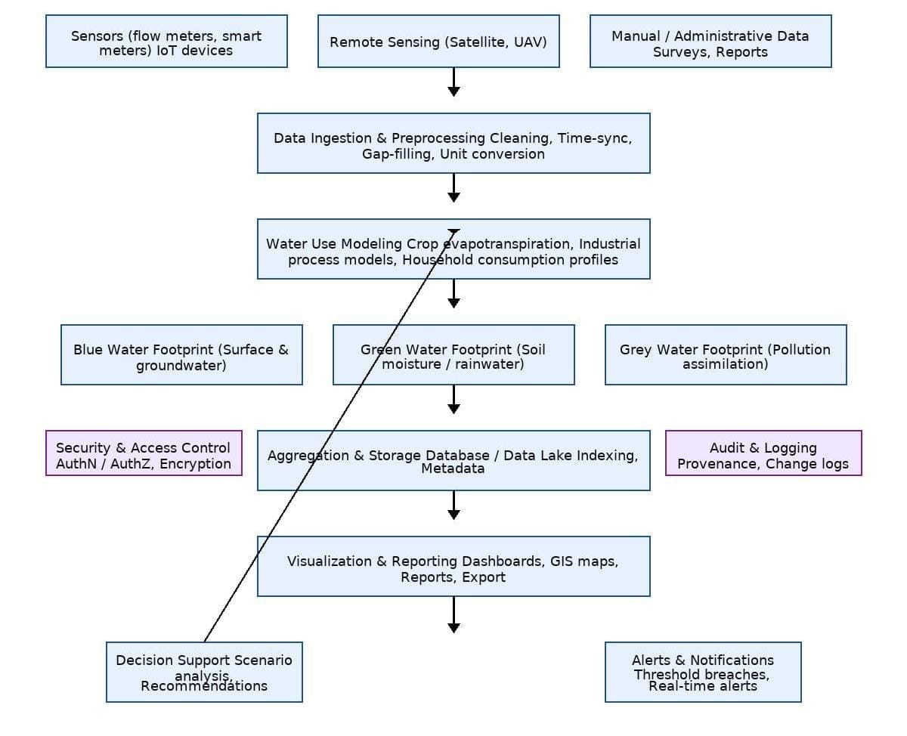
Architecture
Fig 1.System Flow Chart

Slide 16
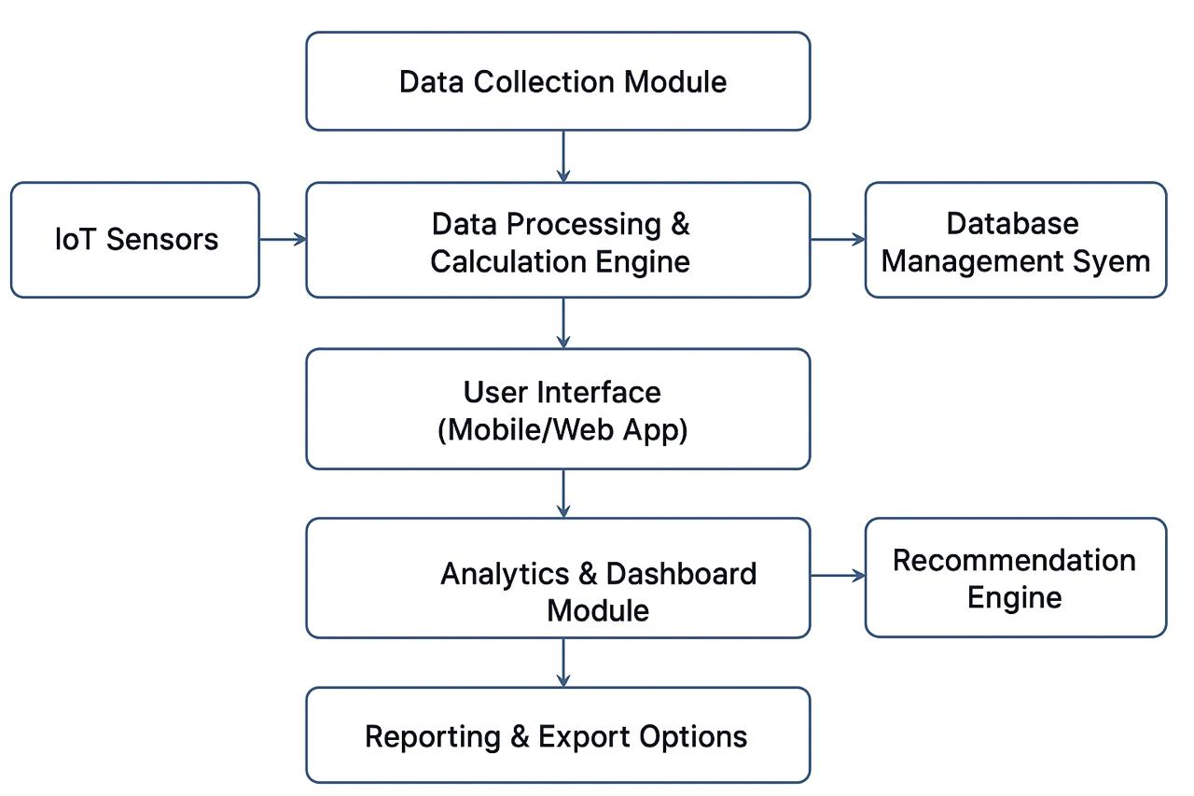
Architecture
Fig 2. Block Diagram

Slide 17
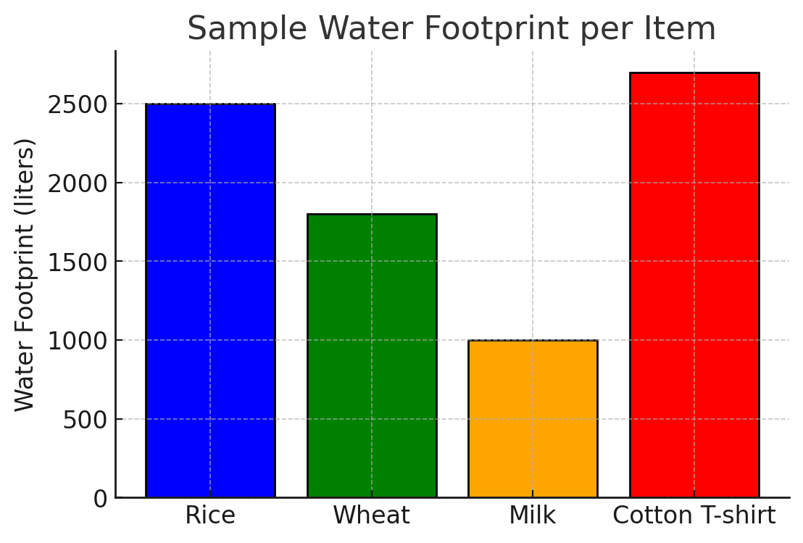
Result
Fig 3.Result

Slide 18
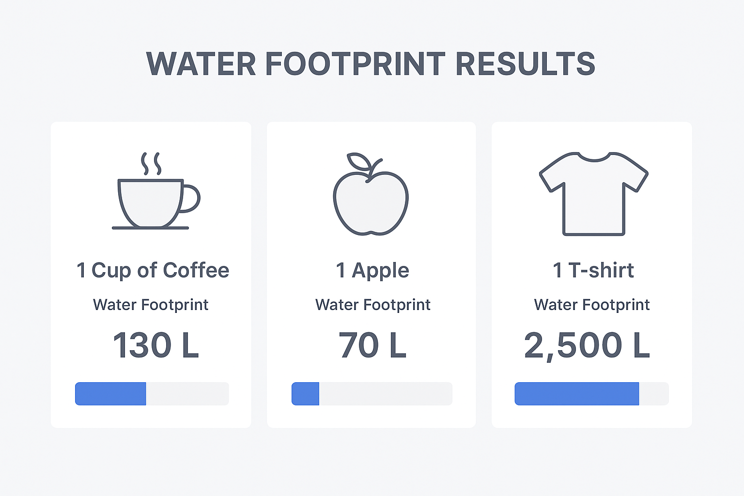
Result
Fig 4.Result

Slide 19
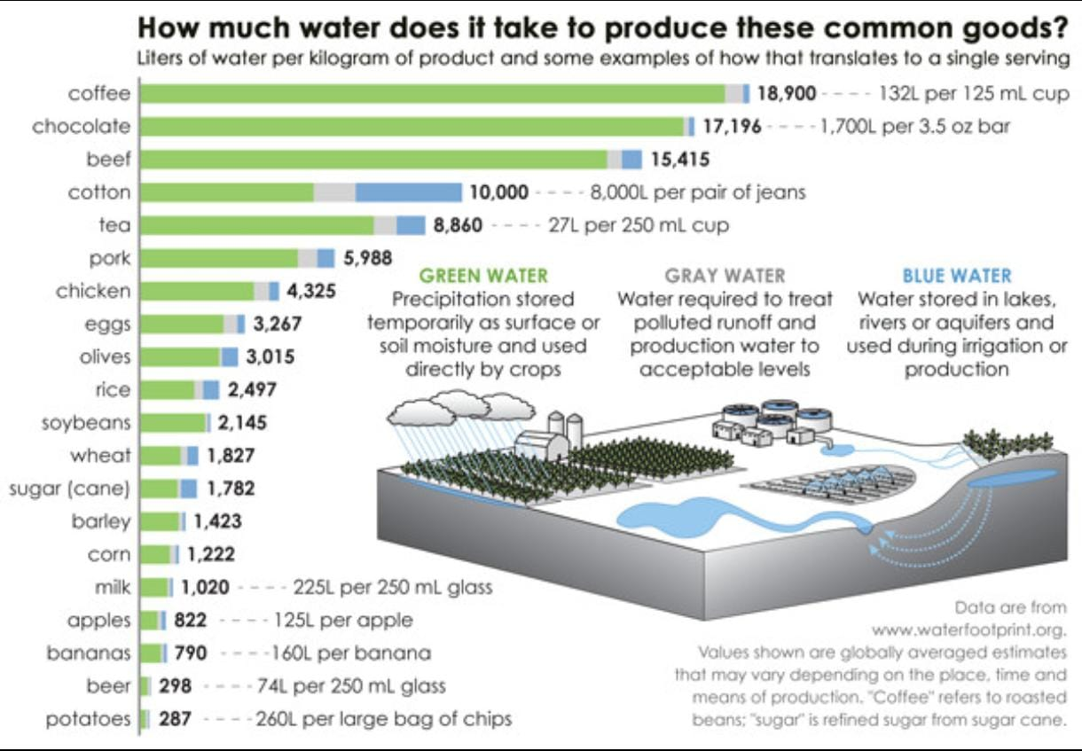
Result
Fig 5.Result

Slide 20
Conclusion
The project aligns with global sustainability goals, particularly
SDG 6 (Clean Water and Sanitation) and SDG 12 (Responsible Consumption and Production),
promoting environmental responsibility at the individual and community levels.Future
enhancements may include integrating AI for predictive analytics, expanding real-time IoT
monitoring, adding region-specific datasets, and collaborating with environmental
organizations to make the tool widely accessible. Overall, this project provides a scalable and
impactful solution for encouraging water-smart lifestyles through the use of digital technology.
The implementation of the digital water footprint calculation system successfully meets the
objectives of promoting awareness, simplifying complex calculations, and enabling users to
make informed decisions about their daily water consumption.

Slide 21
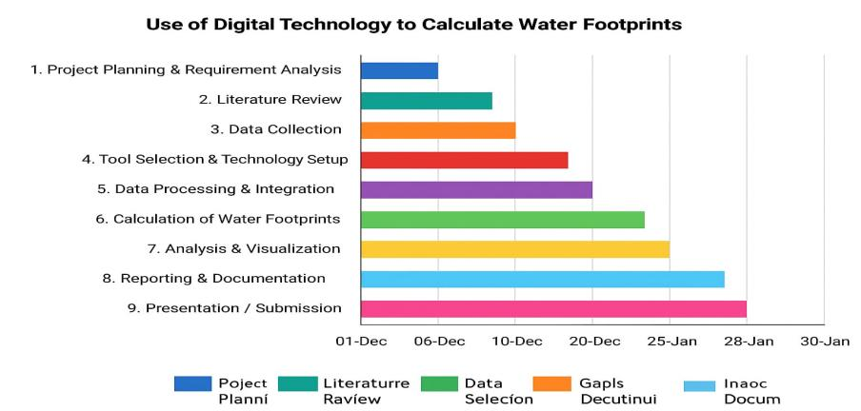
TimeLine (Gantt Chart)
Fig 6. Gantt Chart

Slide 22
References
[1] A. Y. Hoekstra, A. K. Chapagain, M. M. Aldaya, and M. M. Mekonnen, Water Footprint
Manual: State of the Art 2011, Water Footprint Network, 2011.
[2] J. Allan, Virtual Water: Tackling the Threat to Our Planet’s Most Precious Resource,
London, U.K.: I.B. Tauris, 2011.
[3] M. M. Mekonnen and A. Y. Hoekstra, “The green, blue and grey water footprint of crops and derived crop products,” Hydrol. Earth Syst. Sci., vol. 15, no. 5, pp. 1577–1600, May
2011.
[4] L. Zhang, Y. Wang, and J. Li, “IoT-based water monitoring system for smart cities,” IEEE
Sensors J., vol. 19, no. 12, pp. 4567–4575, Jun. 2019.
[5] R. Smith, J. Brown, and M. Green, “Digital tools for sustainability education,”
Sustainability, vol. 12, no. 3, Art. No. 987, Feb. 2020.

Slide 23
References
[6] P. Jones, S. Taylor, and K. Wilson, “Software architecture for environmental footprint
calculation,” Environ. Model. Softw., vol. 45, pp. 1–10, Sep. 2013.
[7] T. Nguyen, H. Tran, and L. Pham, “Mobile app for water conservation awareness,” Int. J.
Environ. Res., vol. 14, no. 2, pp. 123–134, Apr. 2020.
[8] K. Patel, S. Shah, and R. Desai, “Integration of IoT and databases for environmental
monitoring,” IEEE Access, vol. 7, pp. 12345–12356, 2019.

Slide 24


